Slide 1


Constance Adusei
7th January, 2023

Slide 2

Outline
Executive Summary
Introduction
Methodology
Results
Conclusion
Appendix

Slide 3
Executive Summary
Summary of Methodologies
Data Collection with API and Web Scraping with BeautifulSoup
Exploratory Data Analysis (EDA) with SQL
Exploratory Data Analysis (EDA) using Pandas and Matplotlib
Data Visualization with Folium
Interactive Dashboard with Plotly Dash
Predictive Analytics
Summary of all results
EDA results and visualization
Folium maps and plotly dashboards
Classification prediction

Slide 4
Introduction
Background and Context of the Project
This project aims to predict whether the first stage of Falcon 9 launch will land successfully or not. A successful landing of Falcon 9 first stage is reused by SpaceX thereby reducing the cost of the rocket launch to 62 million dollars compared to other companies’ cost of 165 million dollars. . By determining if the stage will land, we can determine the cost of a launch. This information will be useful to a company that wants to compete with SpaceX
Problems you want to find answers
What are the main characteristics of a successful or failed landing ?
What are the effects of each relationship of the rocket variables on the success or failure of a landing?
What are the conditions which will allow SpaceX to achieve the best landing success rate ?

Slide 5

Section 1

Slide 6
Methodology
Executive Summary
Data collection methodology:
SpaceX REST API
Web Scrapping from Wikipedia
Perform data wrangling
Dropping unnecessary columns
One Hot Encoding for classification models
Perform exploratory data analysis (EDA) using visualization and SQL
Perform interactive visual analytics using Folium and Plotly Dash
Perform predictive analysis using classification models
How to build, tune, evaluate classification models

Slide 7
Data Collection
The Space X REST API URL : "https://api.spacexdata.com/v4/launches/past"
Flowchart for SpaceX REST API Data Collection
URL for Wikipedia web scrapping with BeautifulSoup is https://en.wikipedia.org/w/index.php?title=List_of_Falcon_9_and_Falcon_Heavy_launches&oldid=1027686922
Flowchart
SpaceX REST API call
JSON file from API call
DataFrame from JSON file
Data Cleaning and csv Exportation
Get HTML response from Wikipedia
Extracting Data with BeautifulSoup
Making DataFrame from the Extracted Data
Data Cleaning and csv Exportation

Slide 8
Data Collection – SpaceX API
Flowchart for Data Collection with SpaceX REST API
API Response Filter for Falcon9
Conversion of API Dealing with Missing Data
Response to
JSON file
DataFrame
Creation
Dictionary creation Export the DataFrame to a csv file
From the JSON
file
GitHub link to the code
https://github.com/Constance-Adusei/Cousera/blob/main/Caption_project/Webscraping_spx.ipynb

Slide 9
Data Collection – Scraping
Flowchart for Data Collection with BeautifulSoup from Wikipedia
HTML Response
Create a BeautifulSoup Export the
object from the dataframe to acsv
HTML response Create a data frame file
by parsing the
launch HTML tables
Extract all column
names from the
HTML table header
GitHub link to the code
https://github.com/Constance-Adusei/Cousera/blob/main/Caption_project/webscraping_wiki.ipynb

Slide 10
convert those outcomes into Training Labels with 1 means the booster successfully landed 0 means it was unsuccessful
convert those outcomes into Training Labels with 1 means the booster successfully landed 0 means it was unsuccessful
convert those outcomes into Training Labels with 1 means the booster successfully landed 0 means it was unsuccessful
Data Wrangling
In order to understand the dataset and perform machine learning analysis
The data were explored using pandas functions like value_counts, dtypes etc
The landing outcomes were converted into Training Labels with 1 meaning the booster successfully landed 0 meaning it was unsuccessful
Flowchart for the data wrangling process
Link to GitHub code: https://github.com/Constance-Adusei/Cousera/blob/main/Caption_project/labs-jupyter-spacex-Data%20wrangling.ipynb
Calculate the launches number for each site
Calculate the number and occurrence of each orbit
Calculate number and occurrence of mission outcomes per orbit type
Create landing outcome label from Outcome column
Export to csv file

Slide 11
EDA with Data Visualization
Data visualization draws more insights into the dataset
Scatter Graphs
Flight Number vs. Payload Mass
Flight Number vs. Launch Site
Payload vs. Launch Site
Orbit vs. Flight Number
Payload vs. Orbit Type
Orbit vs. Payload Mass
A Scatter point chart was used to the show relationships between variables. This relationship is called the correlation
Bar Graph
Success rate vs. Orbit
Bar graphs show the relationship between numeric and categoric variables
Line Graph
Success rate vs. Year
Line graphs show data variables and their trends. Line graphs can help to show global behavior and make predictions for unseen data
GitHub link code: https://github.com/Constance-Adusei/Cousera/blob/main/Caption_project/jupyter-labs-eda-dataviz.ipynb

Slide 12
EDA with SQL
Displaying the names of the unique launch sites in the space mission.
Display 5 records where launch sites begin with the string 'CCA’
Display the total payload mass carried by boosters launched by NASA (CRS).
Display average payload mass carried by booster version F9 v1.1.
List the date when the first successful landing outcome in the ground pad was achieved.
List the names of the boosters which have success in drone ship and have payload mass greater than 4000 but less than 6000.
List the total number of successful and failed mission outcomes.
List the names of the booster_versions which have carried the maximum payload mass.
List the records which will display the month names, failure landing_ouutcomes in drone ship, booster versions, and launch_site for the months in the year 2015.
Rank the count of successful landiing_outcomes between the date 04-06-2010 and 20-03-2017 in descending order
Github link to code: https://github.com/Constance-Adusei/Cousera/blob/main/Caption_project/jupyter-labs-eda-sql-coursera_sqllite.ipynb

Slide 13
Build an Interactive Map with Folium
Folium map object is centered on NASA Johnson Space Center in Houston.
Red circle at NASA Johnson Space Center’s coordinate with a label showing its name (folium.Circle, folium.map.Marker).
Red circles at each launch site coordinates with labels showing the launch site name (folium.Circle, folium.map.Marker, folium.features.DivIcon).
The grouping of points in a cluster to display multiple and different information for the same coordinates (folium.plugins.MarkerCluster).
Markers to show successful and unsuccessful landings. Green for successful landing and Red for unsuccessful landing. (folium.map.Marker, folium.Icon).
Markers to show distance between launch site to key locations (railway, highway, coastway, city) and plot a line between them. (folium.map.Marker, folium.PolyLine, folium.features.DivIcon)
These objects are created in order to understand better the problem and the data. We can show easily all launch sites, their surroundings and the number of successful and unsuccessful landings.
Github link to code: https://github.com/Constance-Adusei/Cousera/blob/main/Caption_project/lab_jupyter_launch_site_location.ipynb

Slide 14
Build a Dashboard with Plotly Dash
Dashboard has a dropdown, pie chart, range slider and scatter plot components
Dropdown allows a user to choose the launch site or all launch sites (dash_core_components.Dropdown).
Pie chart shows the total success and the total failure for the launch site chosen with the dropdown component (plotly.express.pie).
Range slider allows a user to select a payload mass in a fixed range (dash_core_components.RangeSlider).
Scatter chart shows the relationship between two variables, in particular, Success vs Payload Mass (plotly.express.scatter).
Github link to codehttps://github.com/Constance-Adusei/Cousera/blob/main/Caption_project/spacex_dash_app.py

Slide 15
Predictive Analysis (Classification)
Data Preparation
Data Loading
Data Standardization
Train-Test Split of the data
Model preparation
Selection of machine learning algorithms
parameters for each algorithm to GridSearchCV
Training GridSearchModel models with the training dataset
Model evaluation
Get the best hyperparameters for each type of model
Compute accuracy for each model with the test dataset
Confusion Matrix Evaluation
Model comparison
Comparison of models according to their accuracy
Chosen the best model
Flowchart for the Predictive Analysis
GitHub link for code: https://github.com/Constance-Adusei/Cousera/blob/main/Caption_project/SpaceX_Machine%20Learning%20Prediction_Part_5.ipynb
Data Preparation
Model Preparation
Model Comparison
Model Evaluation

Slide 16
Results
Exploratory data analysis results
Interactive analytics demo in screenshots
Predictive analysis results

Slide 17

Section 2

Slide 18
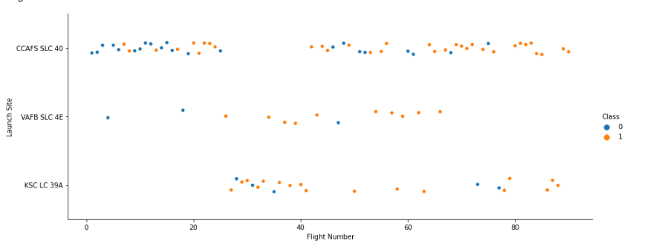
Flight Number vs. Launch Site
A Scatter plot of Flight Number vs Launch Site shows most of the launch from VAFB SLC 4E site was successful compared to the other sites
Most of the launching occurred on the middle and larger flight numbers and the once on the small Flight Numbers were unsuccessful

Slide 19
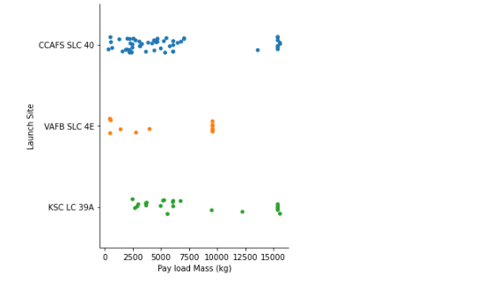
Payload vs. Launch Site
The plot shows that the VAFB-SLC launch site there are no rockets launched for heavy payload mass(greater than 10000).

Slide 20
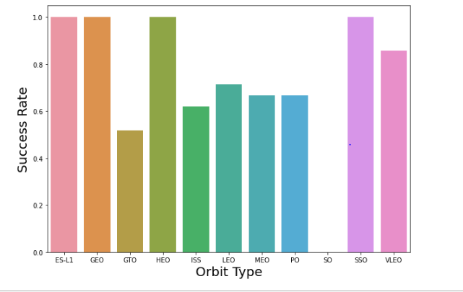
Success Rate vs. Orbit Type
The bar graph shows that Orbit type, ES-L1, GEO, HEO and SSO have high success rate
The graph also shows that the Orbit type SO, has 0 success rate, making it the least with success rate

Slide 21
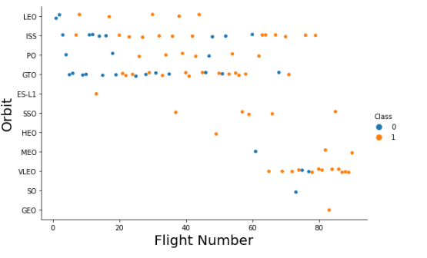
Flight Number vs. Orbit Type
It can be seen from graph that the LEO orbit Success appears related to the number of flights; on the other hand, there seems to be no relationship between flight number when in GTO orbit.

Slide 22
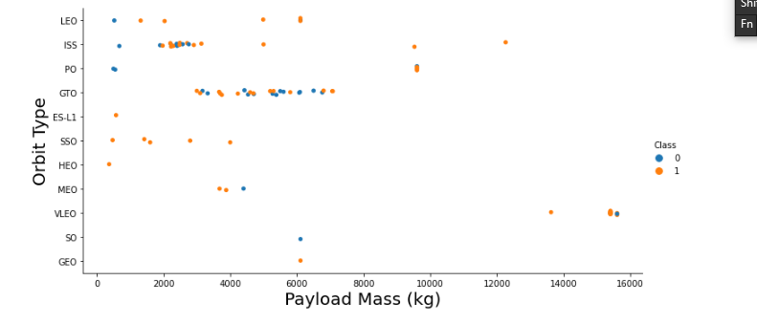
Payload vs. Orbit Type
It can be seen from the graph that’ with heavy payloads the successful landing or positive landing rate are more for Polar, LEO and ISS
However for GTO we cannot distinguish this well as both positive landing rate and negative landing(unsuccessful mission) are both there here

Slide 23
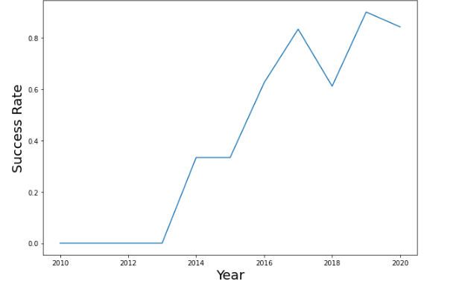
Launch Success Yearly Trend
It can be observed from the graph that the success rate since 2013 kept increasing till 2020

Slide 24
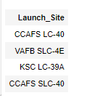
All Launch Site Names
There were four unique launch sites after the query
CCAFS LC-40, VAFB SLC-4E, KSC LC-39A, CCAFS SLC-40 are the sites where the rockets were launch

Slide 25
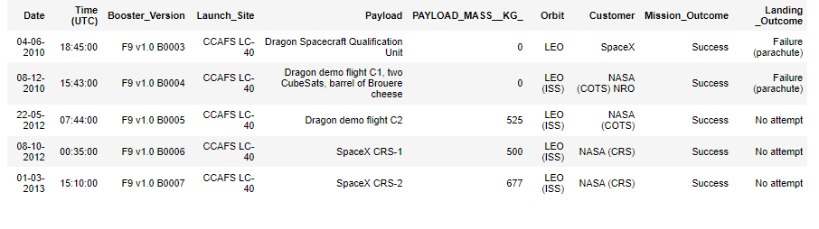
Launch Site Names Begin with 'CCA'
5 records with Launch Sites beginning with CCA

Slide 26
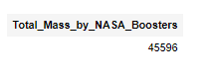
Total Payload Mass
The total payload carried by boosters from NASA is 45596 kg

Slide 27
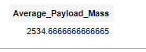
Average Payload Mass by F9 v1.1
The average payload mass carried by booster version F9 v1.1 is 2534.666 kg

Slide 28
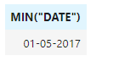
First Successful Ground Landing Date
Finding date minimum from the records gives the dates of the first successful landing outcome on ground pad

Slide 29
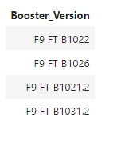
Successful Drone Ship Landing with Payload between 4000 and 6000
List of the names of boosters which have successfully landed on drone ship and had payload mass greater than 4000 but less than 6000

Slide 30
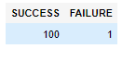
Total Number of Successful and Failure Mission Outcomes
There is 100 total number of successful and 1 failure mission outcomes

Slide 31
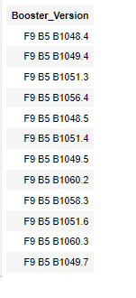
Boosters Carried Maximum Payload
List of the names of the booster which have carried the maximum payload mass

Slide 32
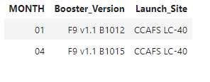
2015 Launch Records
List of the failed landing_outcomes in drone ship, their booster versions, and launch site names for in year 2015

Slide 33
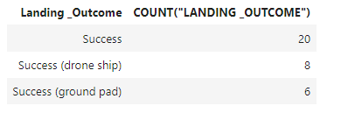
Rank Landing Outcomes Between 2010-06-04 and 2017-03-20
Rank of the count of landing outcomes (such as Failure (drone ship) or Success (ground pad)) between the date 2010-06-04 and 2017-03-20, in descending order

Slide 34

Section 3

Slide 35
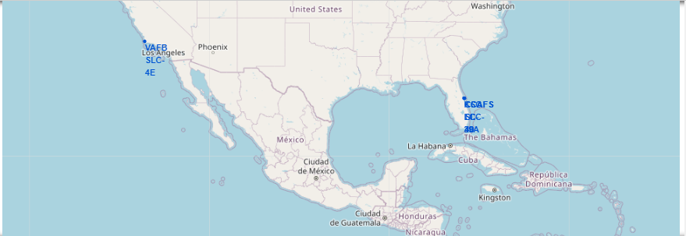
Folium Map of Launch Sites
Geolocation of all launch sites with a blue-colored location marker of each site on a global map
The map shows that all launch sites have very close proximity to the coast and not so close to the Equator line

Slide 36
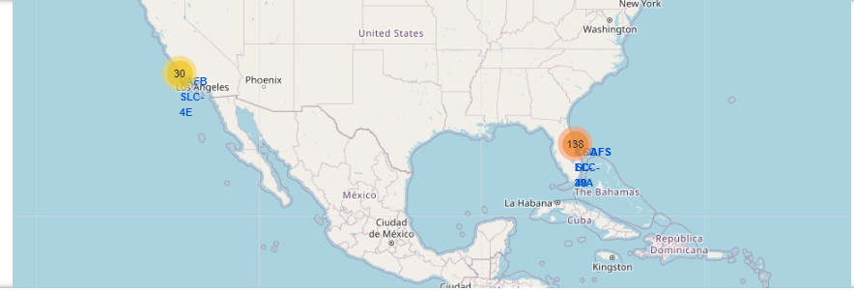
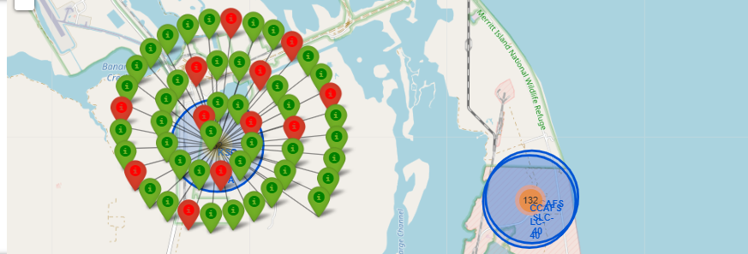
Folium Map of Launch Outcomes
Folium Map showing the launch outcomes for all launch sites
The map shows the number of launches per location and the outcomes of the launches
The green-colored markers show successful launch outcomes and the red-colored ones show unsuccessful launch outcomes

Slide 37
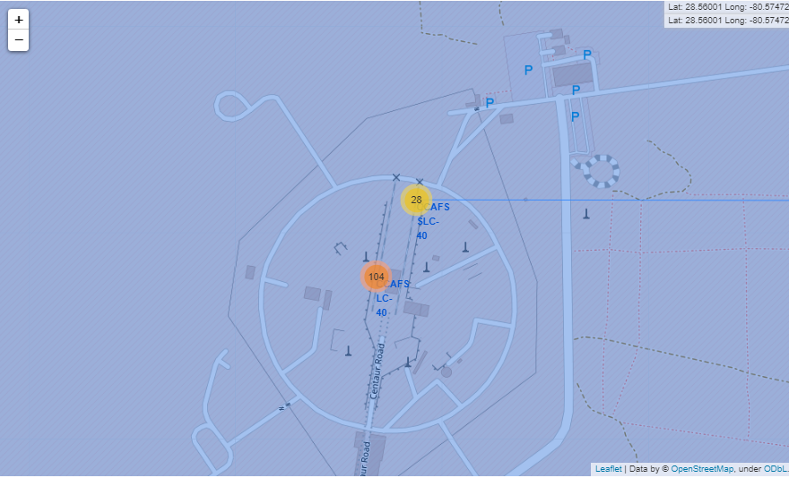
Launch site and its proximities
The map shows CCAFS SLC – 40 launch site with a 0. 87 km distance from the coastline

Slide 38

Section 4

Slide 39
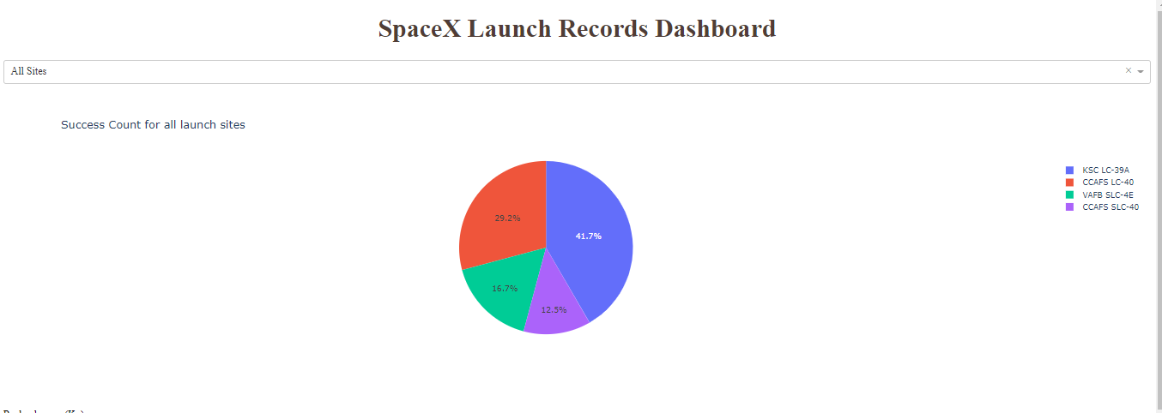
Dashboard – Launch Success of All Sites
Pie chart of the success counts of all launch sites. The chart shows that KSC LC-39A has the best success rate of launches

Slide 40
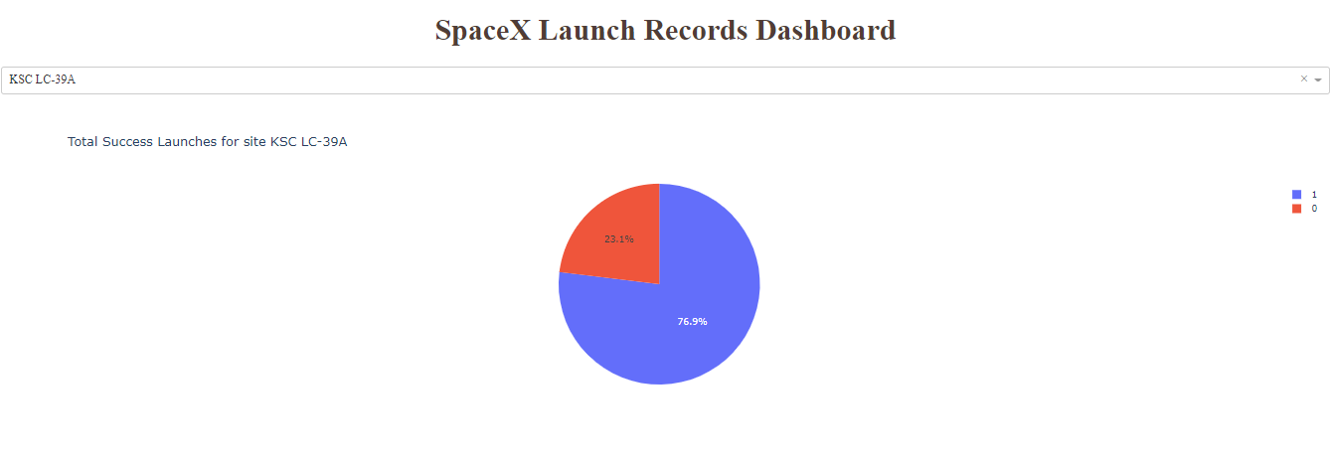
Dashboard – Highest Launch Success Site
KSC LC-39A has the best success rate of launches of 76.9%

Slide 41
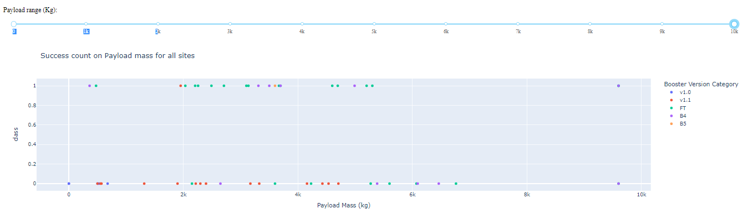
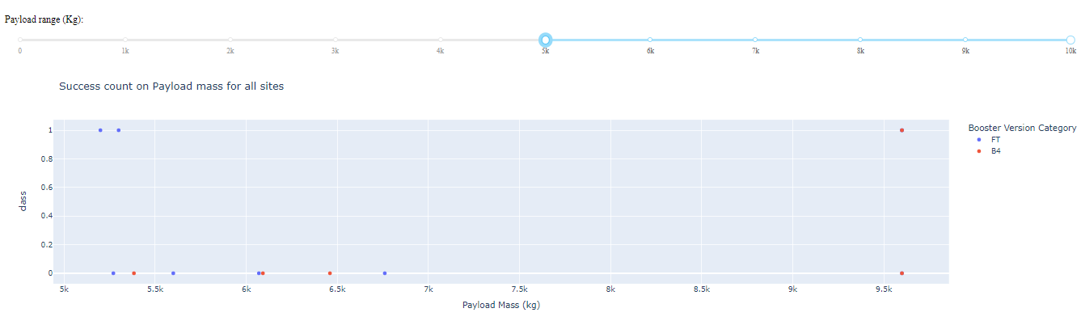
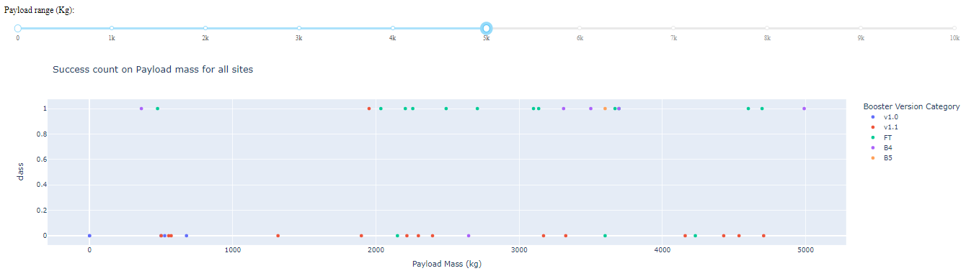
Dashboard - Payload mass vs Outcome for all site
Scatter plot of Payload mass vs Outcome for all site
Heavy-weighted payload (5000 – 10000 kg)
Low-weighted payload (0 – 5000 kg)
Low-weighted payloads have a better success rate than heavy-weighted payloads.

Slide 42

Section 5

Slide 43
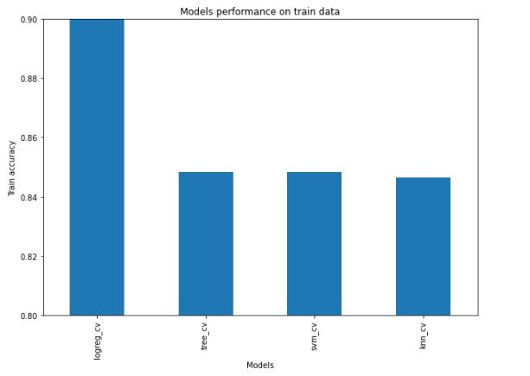
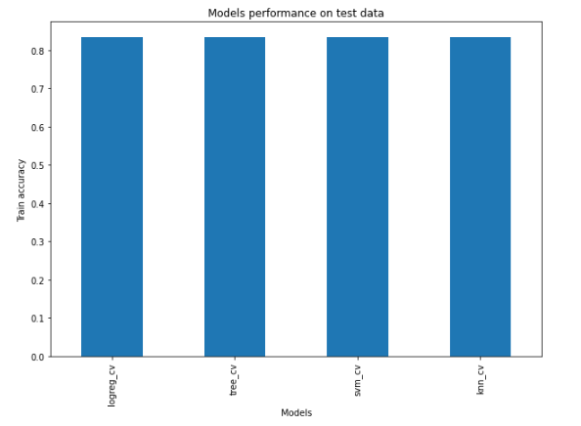
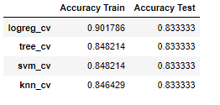
Classification Accuracy
A bar plots visualization of the accuracy of training and testing data shows logistic regression model has the highest accuracy on the training data but all the models perform the same on the test data

Slide 44
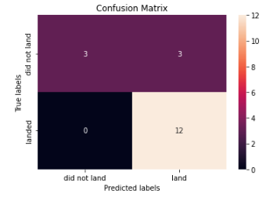
Confusion Matrix
Since all the models performed the same on the test data, their confusion matrix evaluation is the same
The models did not do well predicting the false positives of the dataset

Slide 45
Conclusions
Several criteria, including the launch site, the orbit, and particularly the number of prior launches, can be used to explain the success of a mission. In fact, we might infer that between launches, there was knowledge gained that enabled us to move from a launch failure to a launch success.
The payload mass may be a factor to consider for a mission's success depending on the orbits. It depends on the orbit whether the cargo is light or heavy. However, low-weight payloads typically outperform heavy-weight payloads.
Since all the models performed the same on the test data, the best-performing classification model cannot be determined but twerking some of the parameters of the models will improve their accuracy
The orbits with the best success rates are GEO, HEO, SSO, ES-L1.

Slide 46
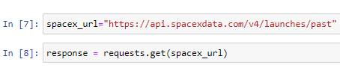
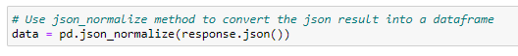
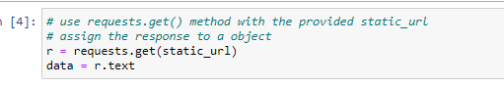
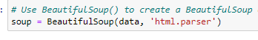
Appendix
Code Snippets for data collection with SpaceX REST API
SpaceX REST API call DataFrame from JSON file
Code Snippets for data collection with BeautifulSoup
Get HTML response from Wikipedia Extracting Data with BeautifulSoup

Slide 47


